Slide 1
Project 2.2
Daniel Chawla, Amber Jessop, Olivia Justynski

Slide 2
CRISPR and personal genomics: The impact of SNPs on sgRNA sets and off target mutations.

Slide 3
Writing
How might SNPs in Carl’s genome impact the use of CRISPR as a treatment? Discuss how individual SNPs would impact the off-target effects in the presence of the SNP.

Slide 4
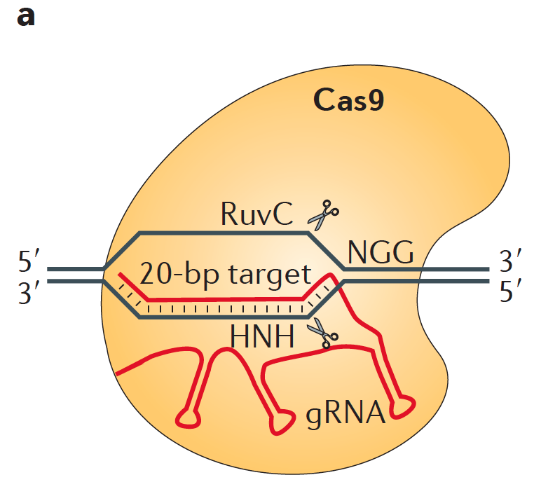

Slide 5
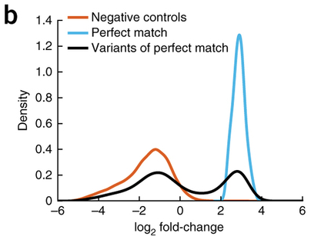

Slide 6
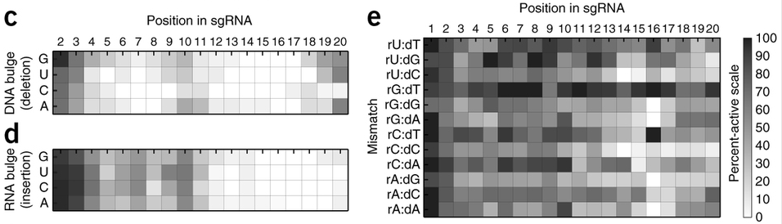

Slide 7
Coding
Propose a tool that finds PAM sites in the human reference genome as well as Carl’s genome and compares the similarity of the two sets.

Slide 8
Coding: Approach
Data I/O
Find PAM Sites
Compare Sets

Slide 9
Coding: Approach
Data I/O
SubjectZ’s genome is aligned against hg37
Read in .fa files for Z and reference genome
Find PAM Sites
Look for 5’-NGG-3’ and 3’-CCN-5’ motifs on each chromosome (store in list)
Compare Sets
Append 20 NTs upstream for specificity
Find intersection of Z and reference PAM+gRNA sequences
Divide by length of reference set

Slide 10
Coding: Implementation
Data I/O
R Bioconductor BioString package
Find PAM Sites
BioString methods for memory-optimized pattern searching
Compare Sets
Subsample first 1000 reference PAM sites and first 1000 Z PAM sites per chromosome to alleviate runtime and memory constraints

Slide 11
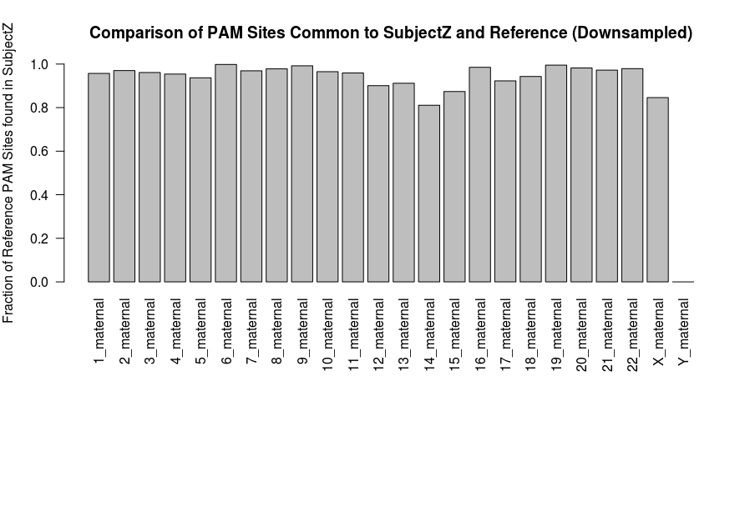
Coding Results

Slide 12
Conclusions
Subject Z’s genome seems to have most PAM sites preserved
The method presented here underestimates preservation because CRISPR does not require perfectly matched guides
Downsampling to 23,000 PAM sites (from several million) is likely to bias results

Slide 13
Pipeline
Calculate the sgRNA libraries for the reference genome and Carl’s genome. How different are these two sets?

